Slide 1
Progress 2016-03-23
Muhammad Arif Nasution
1306500580

Slide 2
Convolutional networks perceive images as volumes; i.e. three-dimensional objects, rather than flat canvases to be measured only by width and height. That’s because digital color images have a red-blue-green (RGB) encoding, mixing those three colors to produce the color spectrum humans perceive. A convolutional network ingests such images as three separate strata of color stacked one on top of the other.
CNN memperlakukan image sebagai volume, yaitu 3d objek, daripada kanvas datar yang dihitung berdasarkan lebar dan tinggi. Hal tersebut dikarenakan image digital memiliki RGB, menggabungkan 3 warna untuk memproduksi warna sesuai perspektif manusia. CNN

Slide 3
Channel
So a convolutional network receives a normal color image as a rectangular box whose width and height are measured by the number of pixels along those dimensions, and whose depth is three layers deep, one for each letter in RGB. Those depth layers are referred to as channels.
CNN mengambil warna normal dari gambar kedalam sebuah kotak dengan panjang dan lebar dihitung berdasarkan jumlah pixel sesuai dimensi gambar dan memiliki 3 depth.
Depth layer adalah channel

Slide 4
Activation Map

Slide 5
Stride
Jumlah pergerakan
Untuk menciptakan activation map

Slide 6
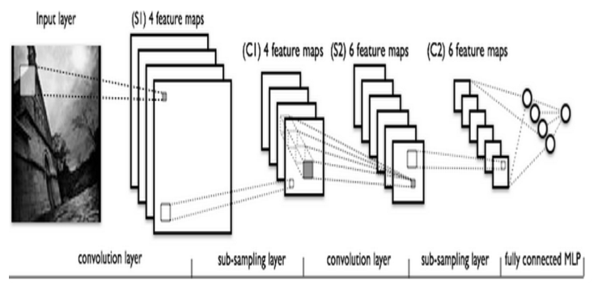
Arsitektur

Slide 7
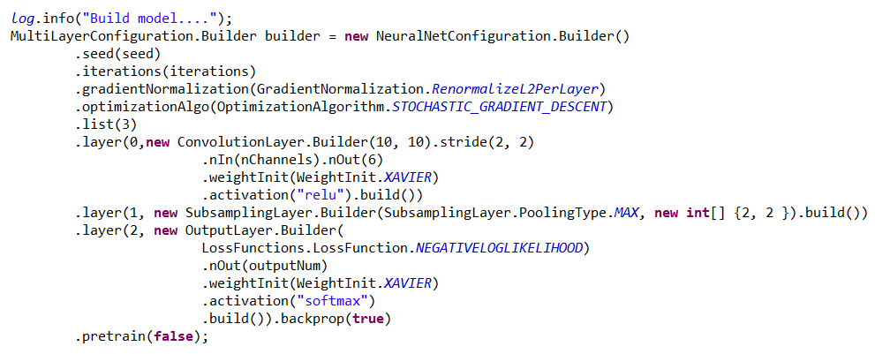
Source Code

Slide 8
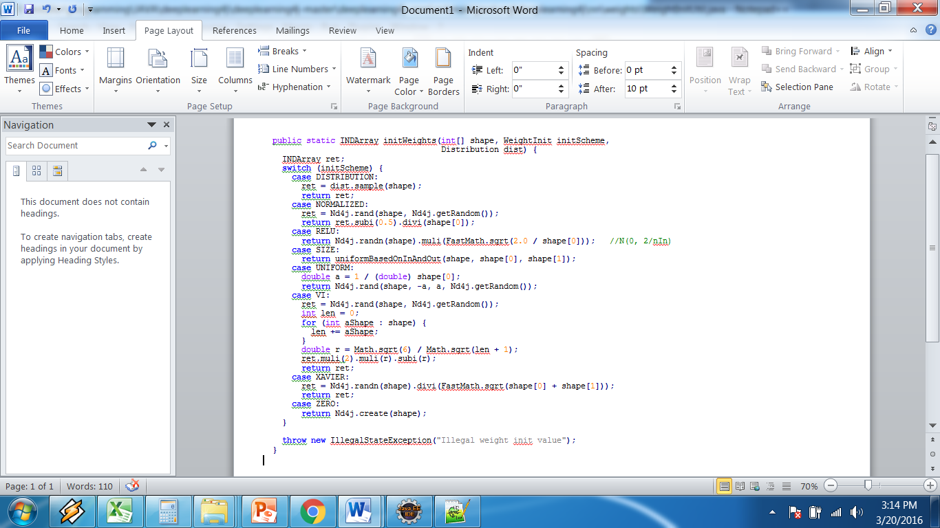
org.deeplearning4j.nn.weights. WeightInitUtil

Slide 9
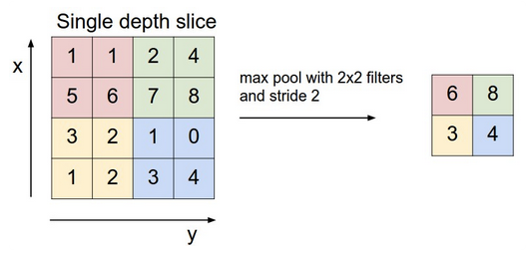
Sample Pooling

Slide 10
Representasi

